Slide 1

For Live Session #3
Javier Saldana

Slide 2
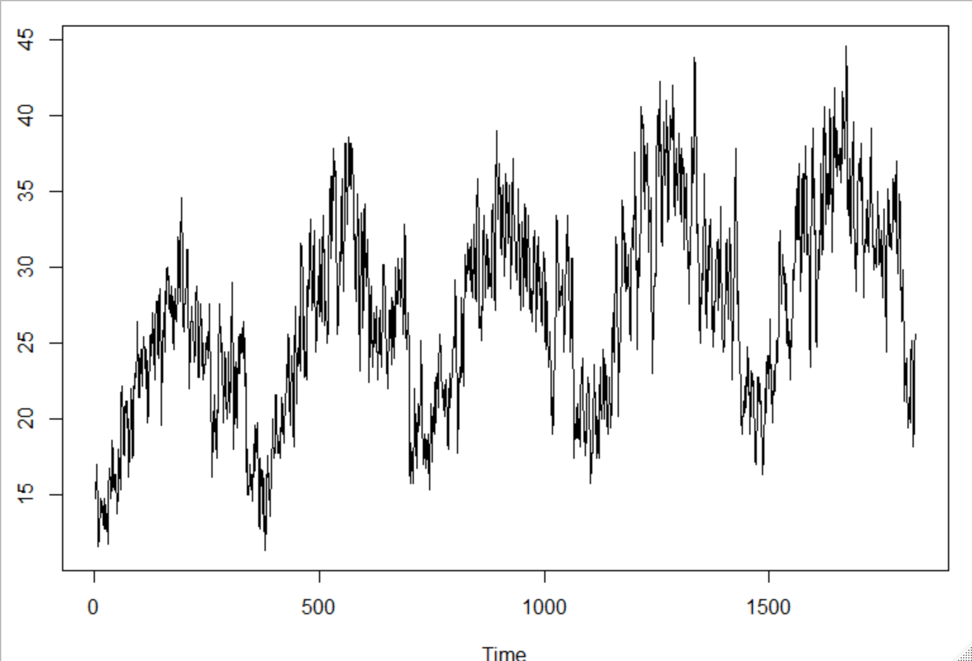
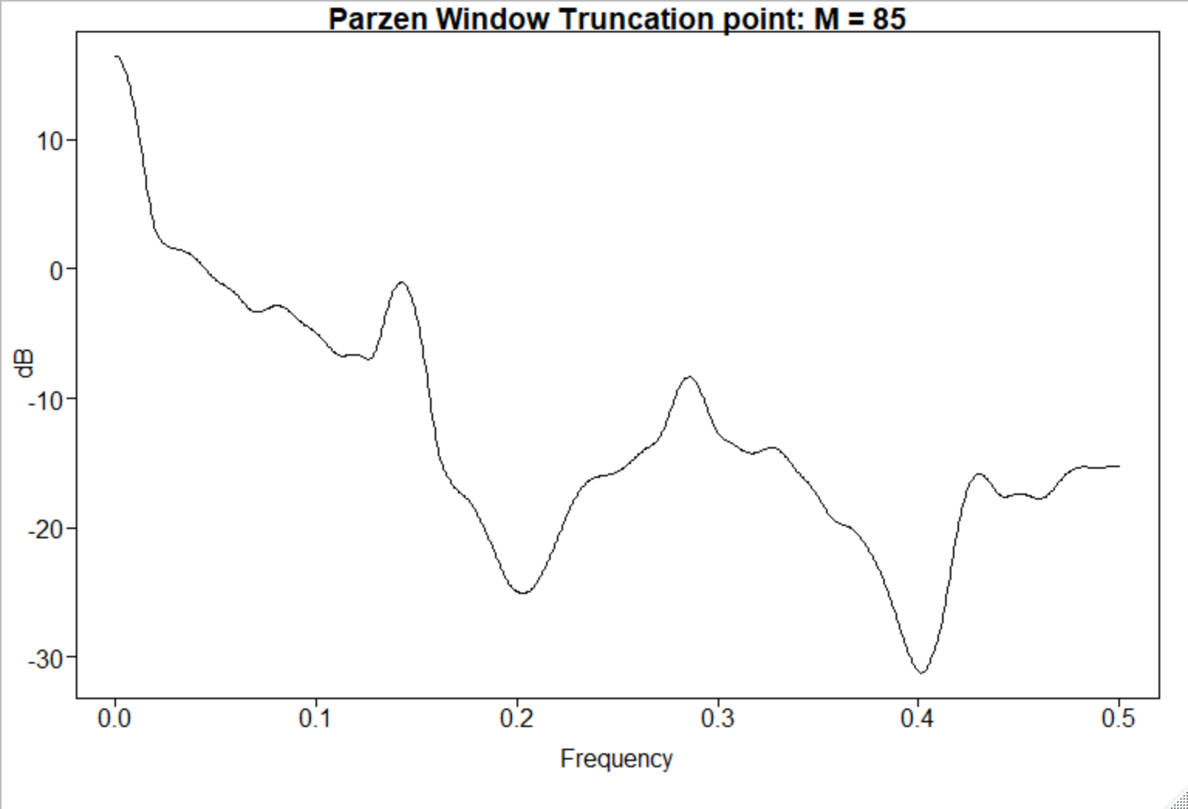
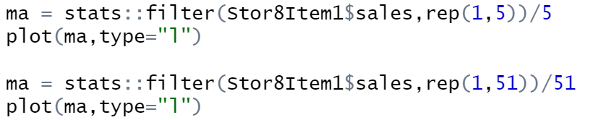
Walmart.csv filtered to Store #8 & Item #1
5-point Moving Average
Spectral Density

Slide 3
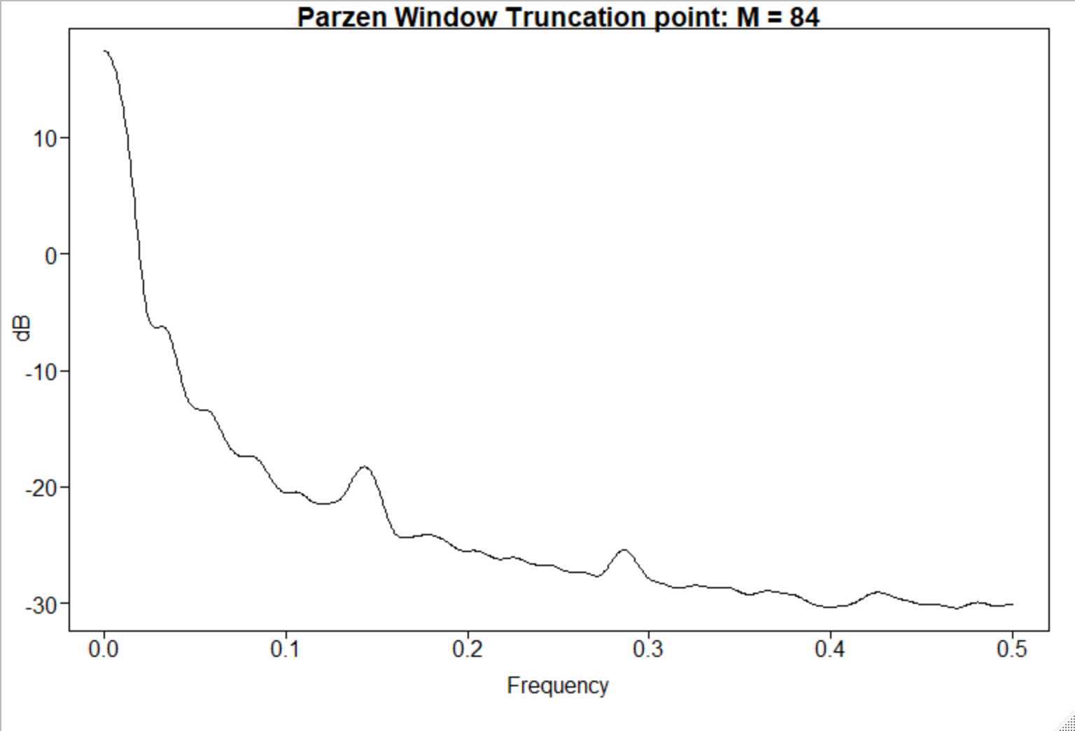
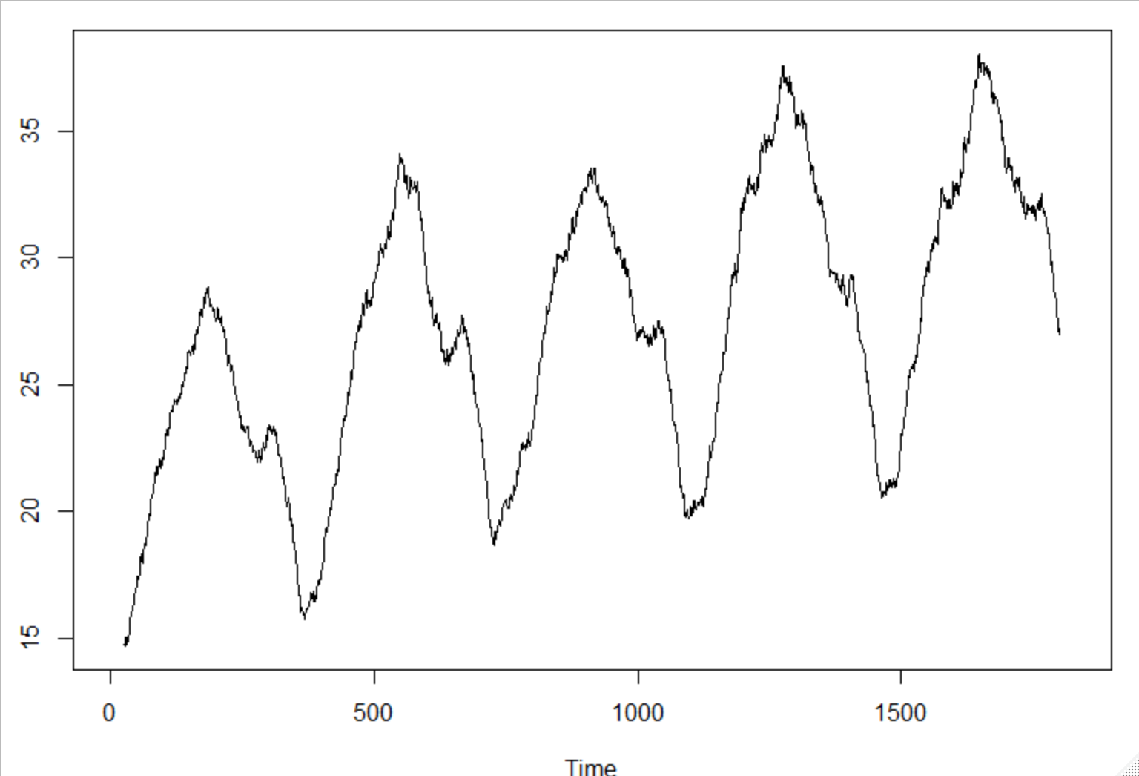
Walmart.csv filtered to Store #8 & Item #1
Spectral Density
51-point Moving Average

Slide 4




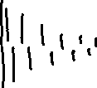

AR(1): X _{t} – φ ₁X_{t – 1} = a_{t}
Stationarity:
Stationary iff |$φ_{1}$| ______
Autocorrelation:
$$ρ_{1}= for k ≥1$$
damped exponential
(oscillating if ϕ₁ <0)
Realizations look like:
ϕ₁ > 0 :
ϕ₁ < 0 :
Spectrum:
has a peak at f = __ (ϕ₁ > 0) or f =____ (ϕ₁ < 0)

